Slide 1
Struktur Data
Pointer

Slide 2
Implementasi ADT
Setelah membuat ADT kita bisa mengimplementasikannya menjadi tipe data baru
Tipe data baru tersebut disusun dari tipe data – tipe data yang telah ada
  Variabel (DPK)
  Struct (DPK, dibahas lagi di pertemuan kali ini )
  Array (DPK)
  Pointer (DPK, dibahas lagi di pertemuan kali ini )
  Alokasi memori dinamis (pertemuan berikutnya)

Slide 3
Memori Komputer
Komputer menyimpan variabel program di satu atau beberapa slot pada memori
Tiap slot memori memiliki nomor atau alamat tertentu

Slide 4
Di slot memori nomer berapa sebuah variabel disimpan ?
#include <stdio.h>
#include <conio.h>
void main()
{
int x;
x = 10;
printf("x berada di slot memori nomor : %d", &x);
getch();
}
Tambahkan & sebelum variabel x
Notes:
Is there any questions so far?

Slide 5
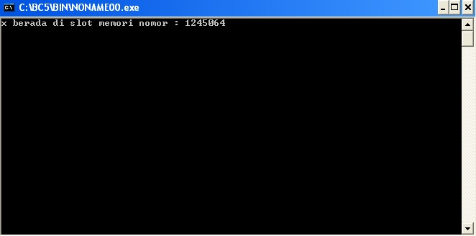
Eksekusi program
Notes:
Is there any questions so far?

Slide 6
Pointer
Nomor atau alamat slot memori di mana variabel disimpan dapat disimpan pada variabel lain
Variabel tersebut dinamakan pointer
Pointer tidak menyimpan isi variabel, tetapi menyimpan alamat / nomor slot di mana isi variabel berada
Notes:
Is there any questions so far?

Slide 7
Contoh
#include <stdio.h>
#include <conio.h>
void main()
{
int x;
int *px;
x = 10;
px = &x;
printf("x berada di slot memori nomor : %d", px);
getch();
}
Notes:
Is there any questions so far?

Slide 8
Eksekusi program
Notes:
Is there any questions so far?

Slide 9
Mengakses nilai variabel
Nilai sebuah variabel bisa diakses melalui dua cara
  Cara 1 : Langsung
  Cara 2 : Menggunakan pointer
Notes:
Is there any questions so far?

Slide 10
Contoh
#include <stdio.h>
#include <conio.h>
void main()
{
int x;
int *px;
x = 10;
px = &x;
printf("nilai x diakses secara langsung : %d\n", x);
printf("nilai x diakses melalui pointer : %d", *px);
getch();
}
Notes:
Is there any questions so far?

Slide 11
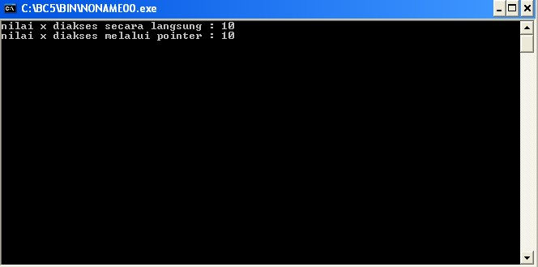
Eksekusi program
Notes:
Is there any questions so far?

Slide 12
An Illustration
int i = 5, j = 10;
int *ptr;
int **pptr;
ptr = &i;
pptr = &ptr;
*ptr = 3;
**pptr = 7;
ptr = &j;
**pptr = 9;
*pptr = &i;
*ptr = -2;
Data Table
Name | Type | Description | Value
i | int | integer variable | 5
j | int | integer variable | 10

Slide 13
An Illustration
int i = 5, j = 10;
int *ptr; /* declare a pointer-to-integer variable */
int **pptr;
ptr = &i;
pptr = &ptr;
*ptr = 3;
**pptr = 7;
ptr = &j;
**pptr = 9;
*pptr = &i;
*ptr = -2;
Data Table
Name | Type | Description | Value
i | int | integer variable | 5
j | int | integer variable | 10
ptr | int * | integer pointer variable

Slide 14
An Illustration
int i = 5, j = 10;
int *ptr;
int **pptr; /* declare a pointer-to-pointer-to-integer variable */
ptr = &i;
pptr = &ptr;
*ptr = 3;
**pptr = 7;
ptr = &j;
**pptr = 9;
*pptr = &i;
*ptr = -2;
Data Table
Name | Type | Description | Value
i | int | integer variable | 5
j | int | integer variable | 10
ptr | int * | integer pointer variable
pptr | int ** | integer pointer pointer variable
Double Indirection

Slide 15
An Illustration
int i = 5, j = 10;
int *ptr;
int **pptr;
ptr = &i; /* store address-of i to ptr */
pptr = &ptr;
*ptr = 3;
**pptr = 7;
ptr = &j;
**pptr = 9;
*pptr = &i;
*ptr = -2;
Data Table
Name | Type | Description | Value
i | int | integer variable | 5
j | int | integer variable | 10
ptr | int * | integer pointer variable | address of i
pptr | int ** | integer pointer pointer variable
*ptr | int | de-reference of ptr | 5

Slide 16
An Illustration
int i = 5, j = 10;
int *ptr;
int **pptr;
ptr = &i;
pptr = &ptr; /* store address-of ptr to pptr */
*ptr = 3;
**pptr = 7;
ptr = &j;
**pptr = 9;
*pptr = &i;
*ptr = -2;
Data Table
Name | Type | Description | Value
i | int | integer variable | 5
j | int | integer variable | 10
ptr | int * | integer pointer variable | address of i
pptr | int ** | integer pointer pointer variable | address of ptr
*pptr | int * | de-reference of pptr | value of ptr (address of i)

Slide 17
An Illustration
int i = 5, j = 10;
int *ptr;
int **pptr;
ptr = &i;
pptr = &ptr;
*ptr = 3;
**pptr = 7;
ptr = &j;
**pptr = 9;
*pptr = &i;
*ptr = -2;
Data Table
Name | Type | Description | Value
i | int | integer variable | 3
j | int | integer variable | 10
ptr | int * | integer pointer variable | address of i
pptr | int ** | integer pointer pointer variable | address of ptr
*ptr | int | de-reference of ptr | 3

Slide 18
An Illustration
int i = 5, j = 10;
int *ptr;
int **pptr;
ptr = &i;
pptr = &ptr;
*ptr = 3;
**pptr = 7;
ptr = &j;
**pptr = 9;
*pptr = &i;
*ptr = -2;
Data Table
Name | Type | Description | Value
i | int | integer variable | 7
j | int | integer variable | 10
ptr | int * | integer pointer variable | address of i
pptr | int ** | integer pointer pointer variable | address of ptr
**pptr | int | de-reference of de-reference of pptr | 7

Slide 19
An Illustration
int i = 5, j = 10;
int *ptr;
int **pptr;
ptr = &i;
pptr = &ptr;
*ptr = 3;
**pptr = 7;
ptr = &j;
**pptr = 9;
*pptr = &i;
*ptr = -2;
Data Table
Name | Type | Description | Value
i | int | integer variable | 7
j | int | integer variable | 10
ptr | int * | integer pointer variable | address of j
pptr | int ** | integer pointer pointer variable | address of ptr
*ptr | int | de-reference of ptr | 10

Slide 20
An Illustration
int i = 5, j = 10;
int *ptr;
int **pptr;
ptr = &i;
pptr = &ptr;
*ptr = 3;
**pptr = 7;
ptr = &j;
**pptr = 9;
*pptr = &i;
*ptr = -2;
Data Table
Name | Type | Description | Value
i | int | integer variable | 7
j | int | integer variable | 9
ptr | int * | integer pointer variable | address of j
pptr | int ** | integer pointer pointer variable | address of ptr
**pptr | int | de-reference of de-reference of pptr | 9

Slide 21
An Illustration
int i = 5, j = 10;
int *ptr;
int **pptr;
ptr = &i;
pptr = &ptr;
*ptr = 3;
**pptr = 7;
ptr = &j;
**pptr = 9;
*pptr = &i;
*ptr = -2;
Data Table
Name | Type | Description | Value
i | int | integer variable | -2
j | int | integer variable | 9
ptr | int * | integer pointer variable | address of i
pptr | int ** | integer pointer pointer variable | address of ptr
*ptr | int | de-reference of ptr | -2

Slide 22
Operasi pada pointer
Apa arti *ptr + 1
?
Apa arti *ptr - 1
?
Apa arti *ptr * 2 and ptr / 2
?

Slide 23
Operasi pada pointer
Apa arti ptr + 1?
Alamat slot sesudahnya!
Apa arti ptr - 1?
Alamat slot sebelumnya!
Apa arti ptr * 2 and ptr / 2?
Invalid operations!!!

